Slide 1
Uart/I2C Interfaces Workshop

Slide 2
UART/I2C
Serial Protocols
Interfaces used amongst microcontrollers (Arduino, Raspberry Pi, MSP430)
Can transfer or receive data from sensors to the MCU

Slide 3
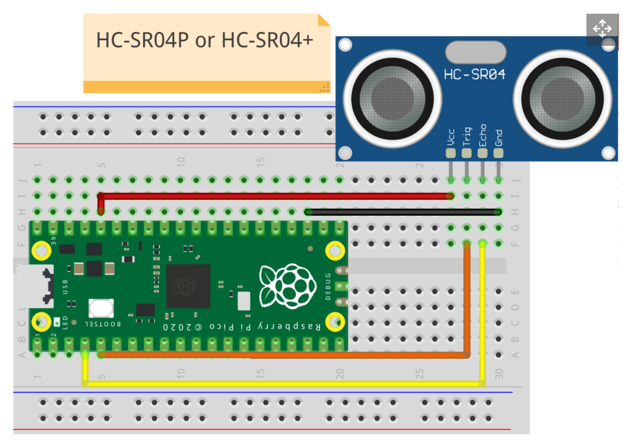
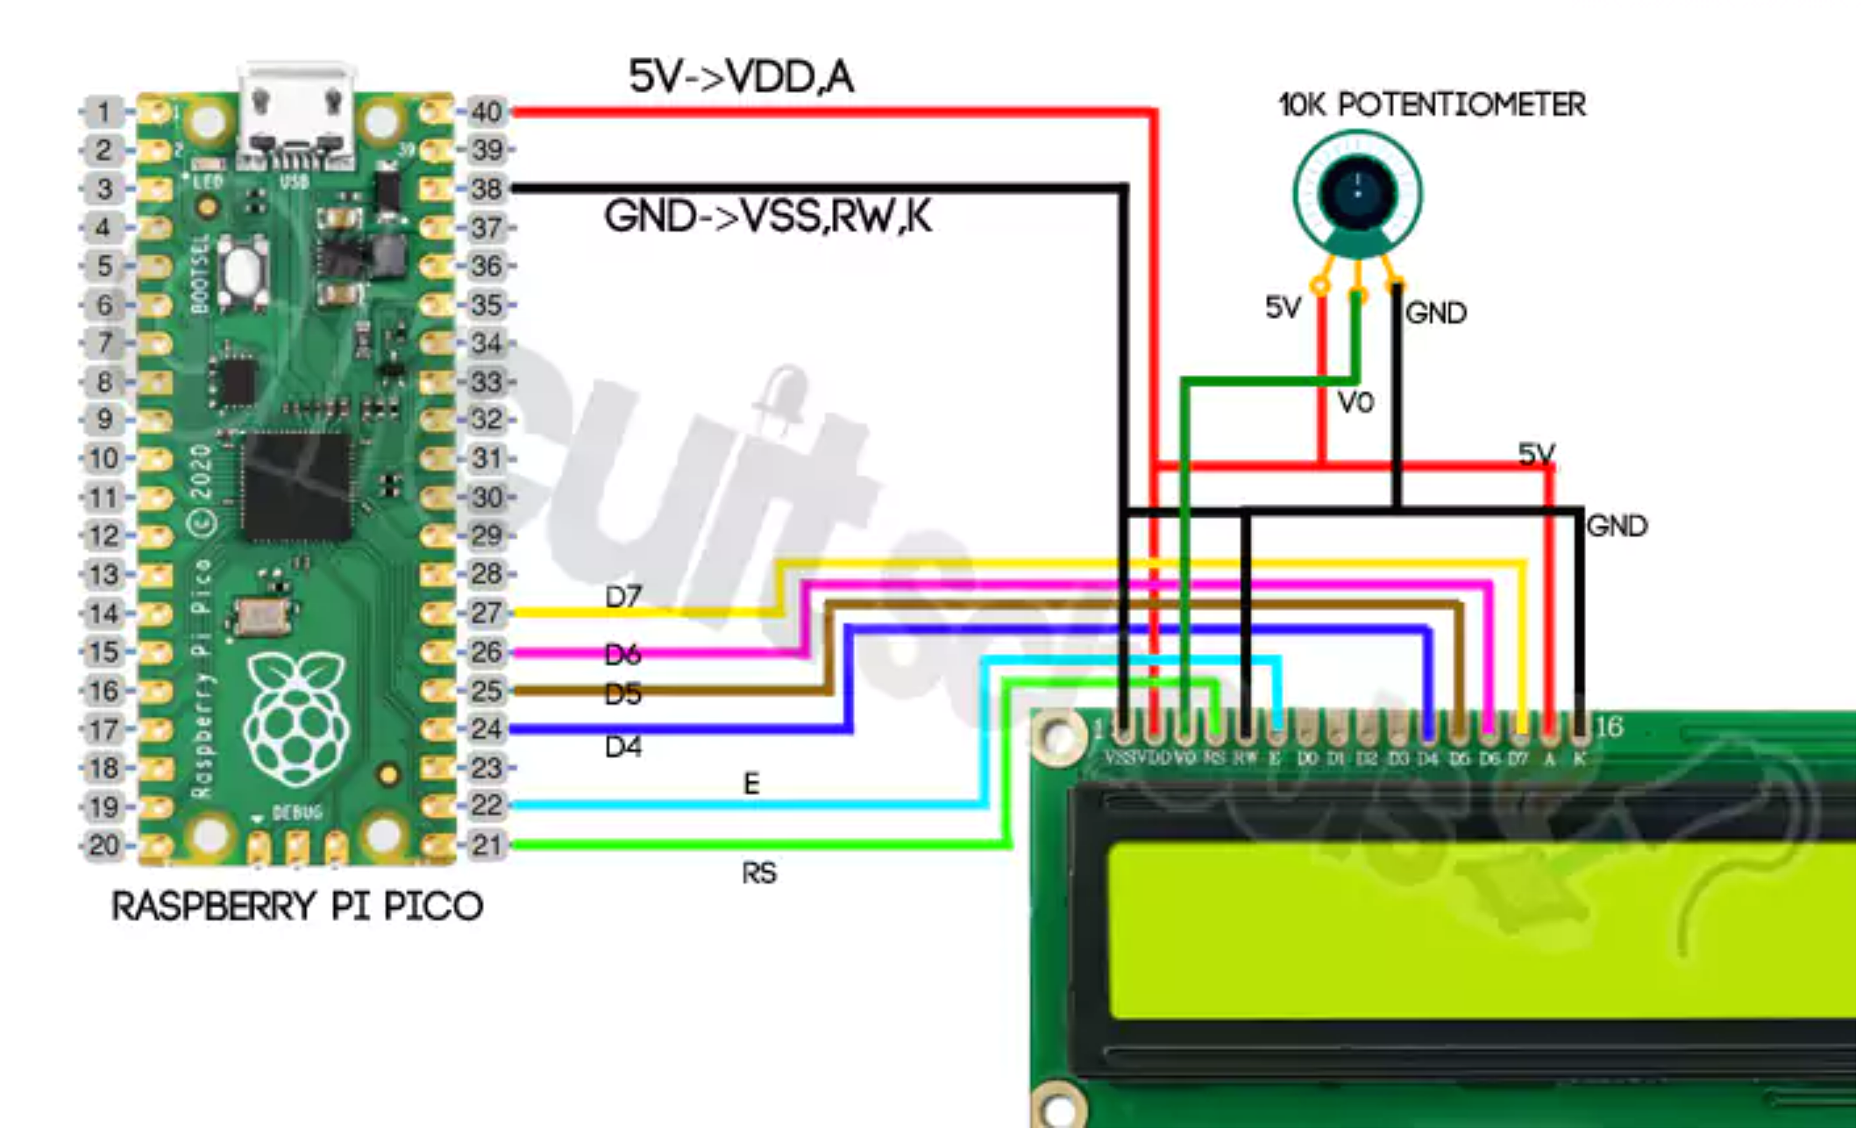
Wiring
Setup our range finder by wiring the Ultrasonic sensor and LCD to the Pico
Connect 5V(VBUS) to VDD, A (LCD) / VCC (Sensor) / 5V (Potentiometer)
Connect GND(PIN 38) to VSS,RW,K (LCD) / GND (Sensor) / GND (Potentiometer)
Connect two GPIO pins to Trig & Echo on Sensor
Connect GPIO pins to RS,E,D4,D5,D6 & D7 on LCD

Slide 4
Code the Ultrasonic sensor setup
Const int trigPin = ?;
Const int echoPin = ?;
void setup() {
Serial.begin(9600);
pinMode(???, OUTPUT);
pinMode(???, INPUT);
}

Slide 5
Code the Lcd setup
const int rs = ?, en = ?, d4 = ?, d5 = ?, d6 = ?, d7 = ?;
LiquidCrystal lcd(rs, en, d4, d5, d6, d7);
lcd.begin(??, ?);
lcd.clear();

Slide 6
Run the code!

Slide 7
Additional Info (I2C Setup)
Wire.h – Built in hardware support for I2C
SoftWire.h - SoftWire softWire = SoftWire();
Include I2C address such as 0x27
I2C header- LiquidCrystal_I2C.h
SDA and SCL Pins
I2C Module/Adapter

